Slide 1

Music Genre Detection
By Tanvi Wagle

Slide 2
Background
Musical genres are labels created by humans to categorize music and more easily define it. However, when asked what are the characteristics of a particular genre, people would answer very differently. The artistry and qualities inherent within music makes it hard to classify. Moreover, genre classification suffers from subjectivity as human perception, experiences and opinions are factors that affect its categorization. Consequently, this problem a non-trivial one.
Historically, music was much less easily produced, shared and consumed. Thus, it was more easily classified. However, with the advent of streaming platforms and related technologies, a rapidly growing database of music has been formed creating the need for more automated means of genre classification.

Slide 3
Objectives
Perform genre classification on a set of music by training a machine learning model
Analyze characteristics of each genre by understanding feature importance and unsupervised genre classification.

Slide 4
Prior Work
“Musical genre classification: Is it worth pursuing and how can it be improved?” By Cory McKay and Ichiro Fujinaga
Explores the Challenges of Genre Detection e.g. lack of agreement of genre classification among humans.
Summarizes psychological and cultural factors associated with musical genre classification
Concludes that although difficult, it has commercial and research value and provides a vocabulary to discuss music .
“Musical Genre Classification of Audio Signals” By George Tzanetakis and Perry Cook
Proposes novel feature extraction to represent timbral texture, rhythmic structure and pitch content
Trained different machine learning model for a variety of genres and sub-genres

Slide 5
AI Principles
“Perception as a User Interface”
Challenges in Genre Detection lies in the fact that there is no source of objective truth
Therefore, relying on classifications for training purposes is difficult.
Genre Classification relies on a variety of non-technical factors, but this project will scope the problem to only work with the audio files.
Explainbility of AI
The objective of this project is not only to classify genres correctly, but also be able to explain the results
Understanding the differences and similarities between genres is valuable as it can help inform the research of musicologists.

Slide 6
Project Components
Dataset Investigation and selection
Previous Research Analysis
Exploratory Data Analysis
Feature Extraction
Train Machine Learning Models
Cross Validation + Hyperparameter Tuning
Unsupervised Learning
Results Collection, Analysis & Conclusions

Slide 7
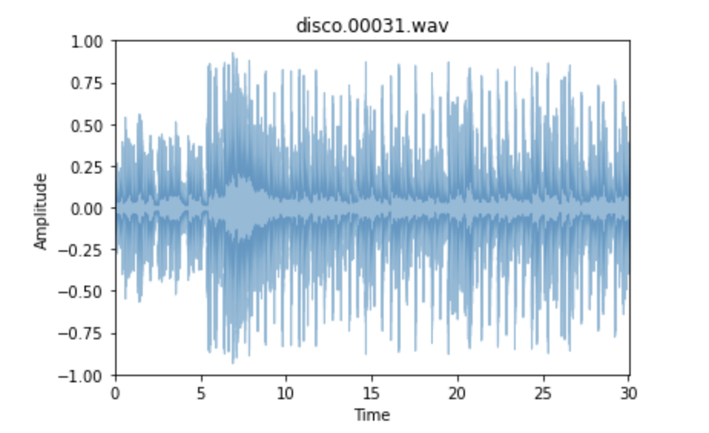
Dataset & Exploratory Data Analysis
GTZAN Genre Collection
1000 audio tracks, 30 seconds long
10 genres and 100 tracks per genre
Spotify Streaming
Selected genre playlists to extract tracks from
5 genres and 110 tracks per genre

Slide 8
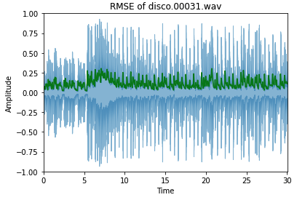
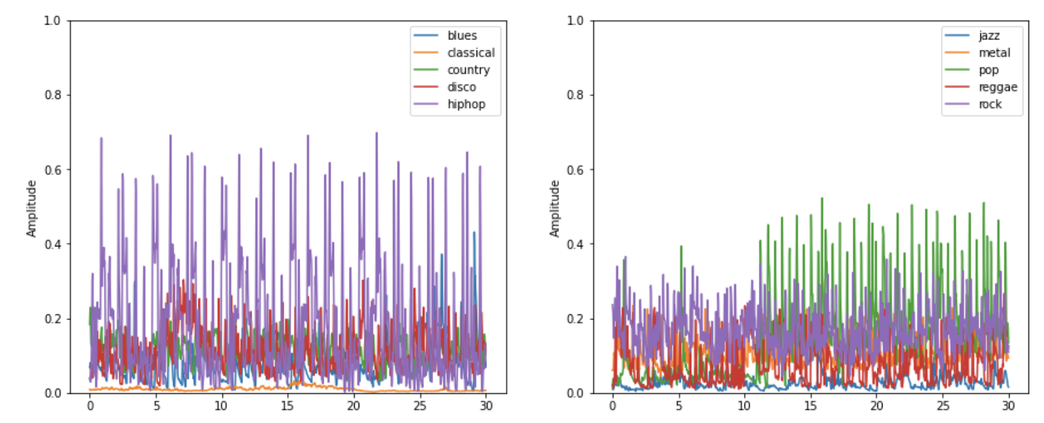
GTZAN Feature Extraction
Common Features Extracted from Audio Files: Root Mean Squared Energy, Chroma Frequencies, MFCCs, Spectral Centroid, Spectral Bandwidth, Tempo, Harmonics, Rolloff, Zero Crossing Rate, Perceptual
Spectral Centroid
Root Mean Squared Energy

Slide 9
Feature Extraction Definitions
Chroma STFT: computes a chromogram (map pitches to 12-scale)
Root Mean Square Energy: the square root of the mean of the amplitude²; indicator of loudness
Spectral Centroid: where most of the energy is concentrated; "brightness of sound"; calculated as the weighted mean of the frequencies
Spectral Bandwidth: variance from the Spectral Centroid; calculated as the weighted distances from the spectral centroid
Spectral Rolloff: approximates maximum frequencies.
Zero Crossing Rate: The number of times the signal crosses the horizontal axis. It is calculated by checking the difference between subsequent samples.
Harmony & Percussive = extract the harmonic and percussive elements of the track
Tempo = beats per minute
Mel-frequency Cepstral Coefficient (MFCC) [1-20] = mathematical transformation to mimic the way humans perceive sound

Slide 10
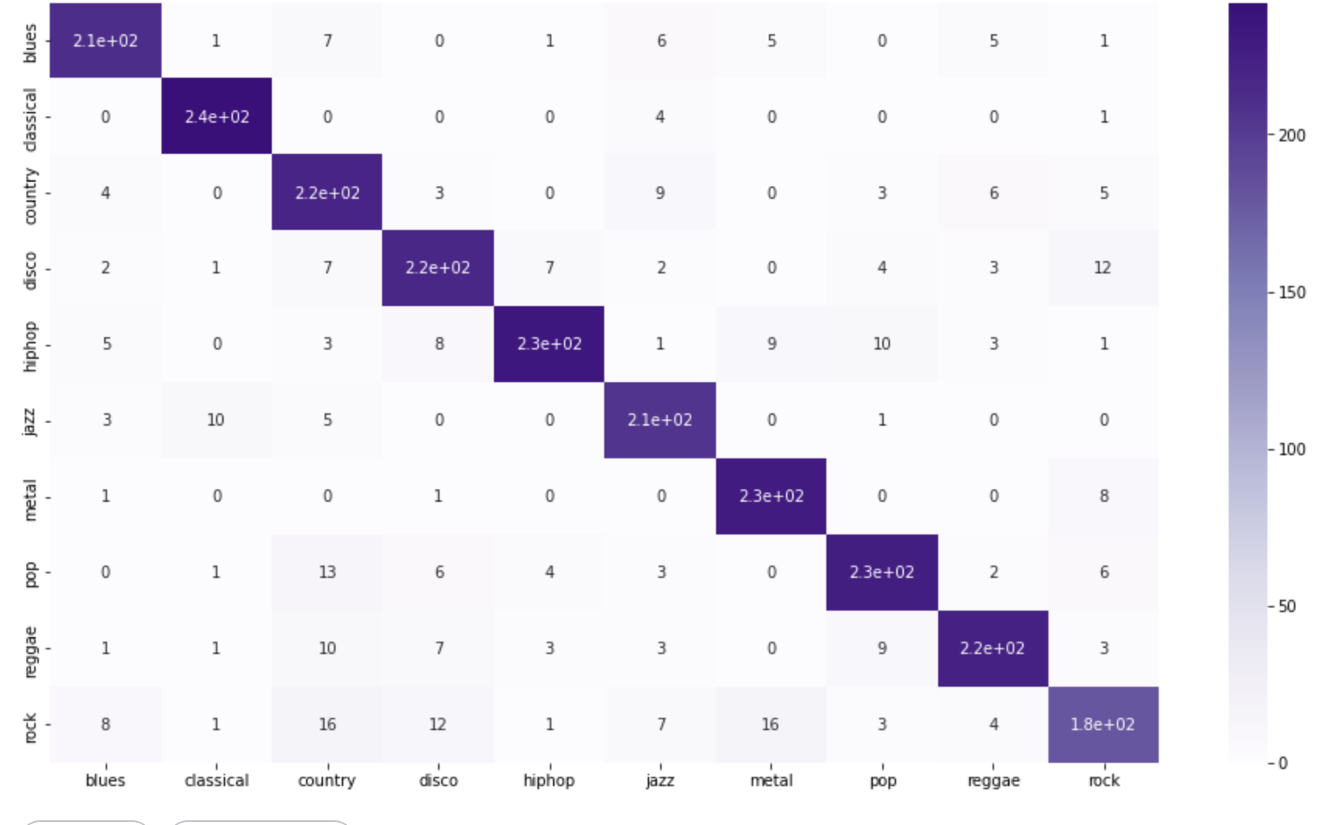
GTZAN Supervised ML Models Results
Confusion Matrix
Preprocess Data
Model Type | Training Accuracy
K-NN | 80%
Decision Tree | 62%
Random Forest | 88%
SVM | 79%
Logistic Regression | 66%
Neural Network | 78%
Split into Train/Test
Train Model
Cross Validation & Hyperparameter Tuning
Test Accuracy of Final Model = 86%
Choose Best Model

Slide 11
GTZAN Confusion Matrix

Slide 12
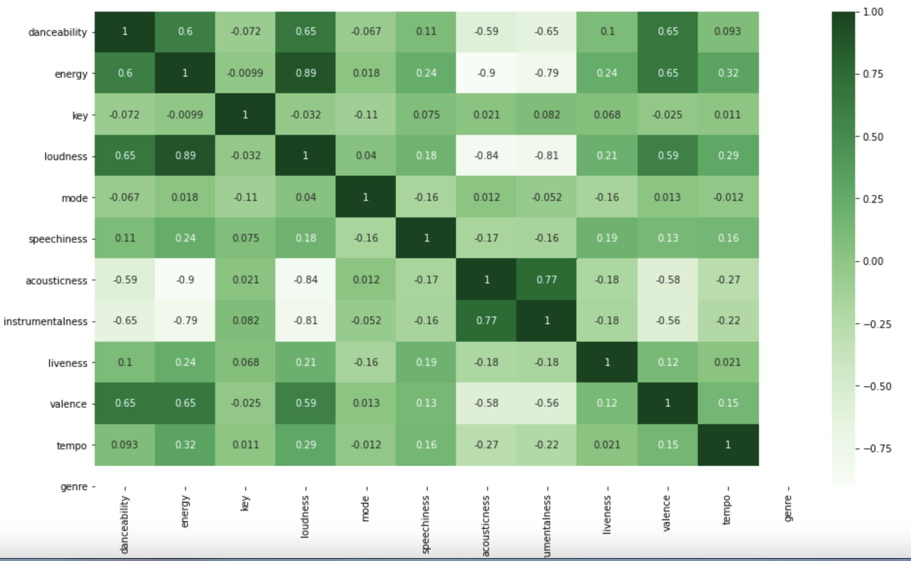
Spotify Features
Danceability = how suitable a track is for dancing
Energy = represents a perceptual measure of intensity and activity.
Key = The key the track is in.
Loudness = The overall loudness of a track in decibels
Mode = Mode indicates the modality (major or minor) of a track.
Speechiness = Speechiness detects the presence of spoken words in a track.
Acousticness = A confidence measure of whether the track is acoustic.
Instrumentalness = Predicts whether a track contains no vocals.
Liveness = Detects the presence of an audience in the recording.
Valence = A measure describing the musical positiveness conveyed by a track.
tempo = estimated tempo of a track in BPM.
Correlation between Features

Slide 13
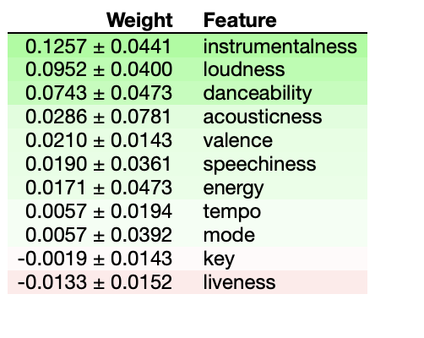
Spotify Supervised ML Models Results
Feature Importance
Preprocess Data
Model Type | Training Accuracy
K-NN | 63%
Decision Tree | 67%
Random Forest | 75%
SVM | 74%
Logistic Regression | 63%
Neural Network | 74%
Split into Train/Test
Train Model
Cross Validation & Hyperparameter Tuning
Choose Best Model
Test Accuracy = 73%

Slide 14
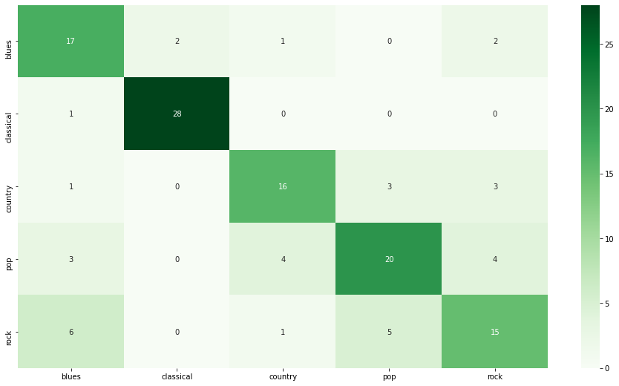
Spotify Confusion Matrix

Slide 15
Spotify K-means Clustering
Motivation: to pursue the second objective of this project by running unsupervised learning algorithms and seeing if it notices patterns that we did not explicitly label
Methodology:
Removed labels from dataset
Used the elbow method to understand how many clusters (i.e. genres) the algorithm determines
Ran K-means
Calculated a modified Confusion Matrix: For each cluster label, calculated the number of each true label.

Slide 16
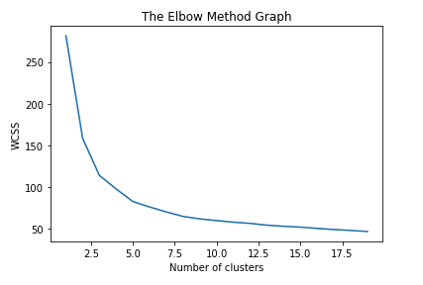
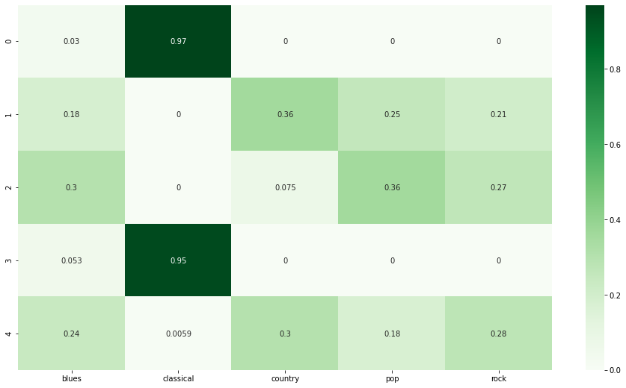
K-means Clustering Results
Confusion Matrix
Using the elbow method, we can identify that the ideal number of clusters is 3 even though there are 4 labels. This indicates that some of the “true” labeled categories are very close to each other.
The confusion matrix shows interesting and surprising results as it splits the classical genre in two different categories. The other labels it did not differentiate between enough.

Slide 17
Future Directions
Hyperparameter Tuning
Room for improvement in the models
Investigate subgenres
Subgenres and overlapping genres is an interesting problem within genre detection to investigate in the future
Expand Dataset
Include more information (especially in the Spotify experiment) such as artist information, release date, number of streams etc.
Image Recognition
Recent work in genre detection has focused on creating frequency visuals from the audio and treating it like an image classification problem

Slide 18
References
G. Tzanetakis and P. Cook. Musical genre classification of audio signals. IEEE Transactions on Speech and Audio Processing, 10(5):293–302, July 2002.
McKay, Cory & Fujinaga, Ichiro. (2006). Musical Genre Classification: Is It Worth Pursuing and How Can It be Improved?.
S. Vishnupriya and K. Meenakshi, "Automatic Music Genre Classification using Convolution Neural Network," 2018 International Conference on Computer Communication and Informatics (ICCCI), 2018, pp. 1-4, doi: 10.1109/ICCCI.2018.8441340.

